Slide 1
Dock Switch Bracket Orientation

Slide 2
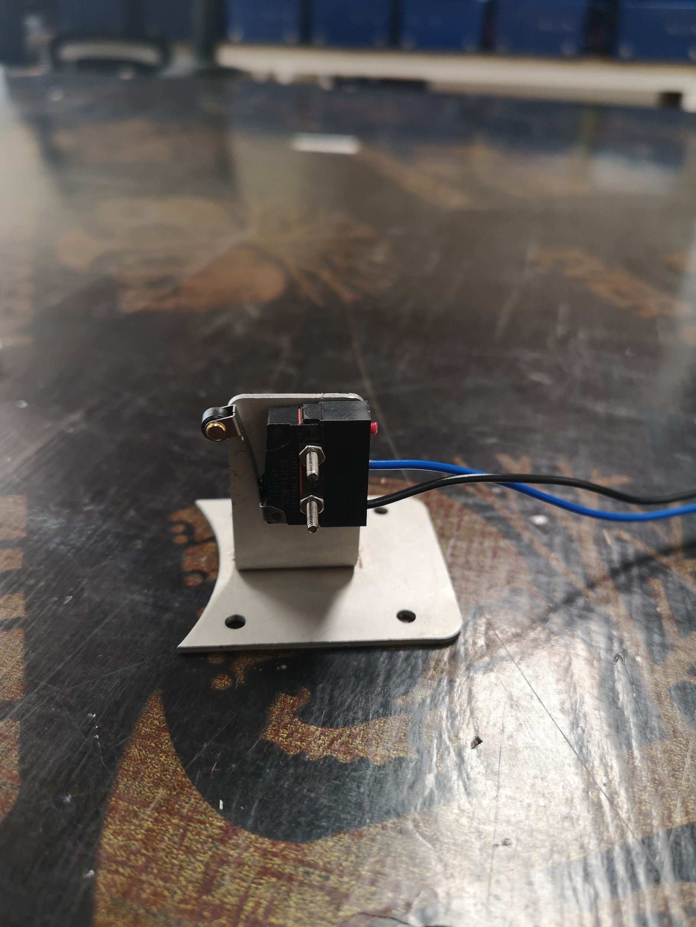
Canister Dock Switch Orientation
The photo shows a wrongly welded canister dock switch bracket
126 pcs of canister dock switch bracket were confirmed wrongly welded
Not All KPs shell came with Canister Dock switch bracket as per the KP Shell summary

Slide 3
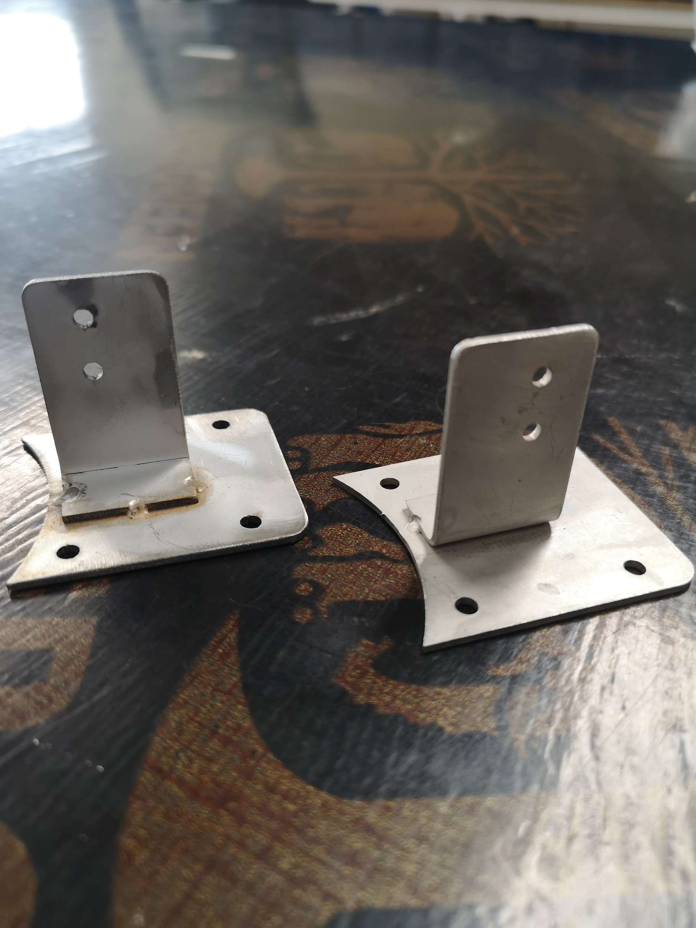
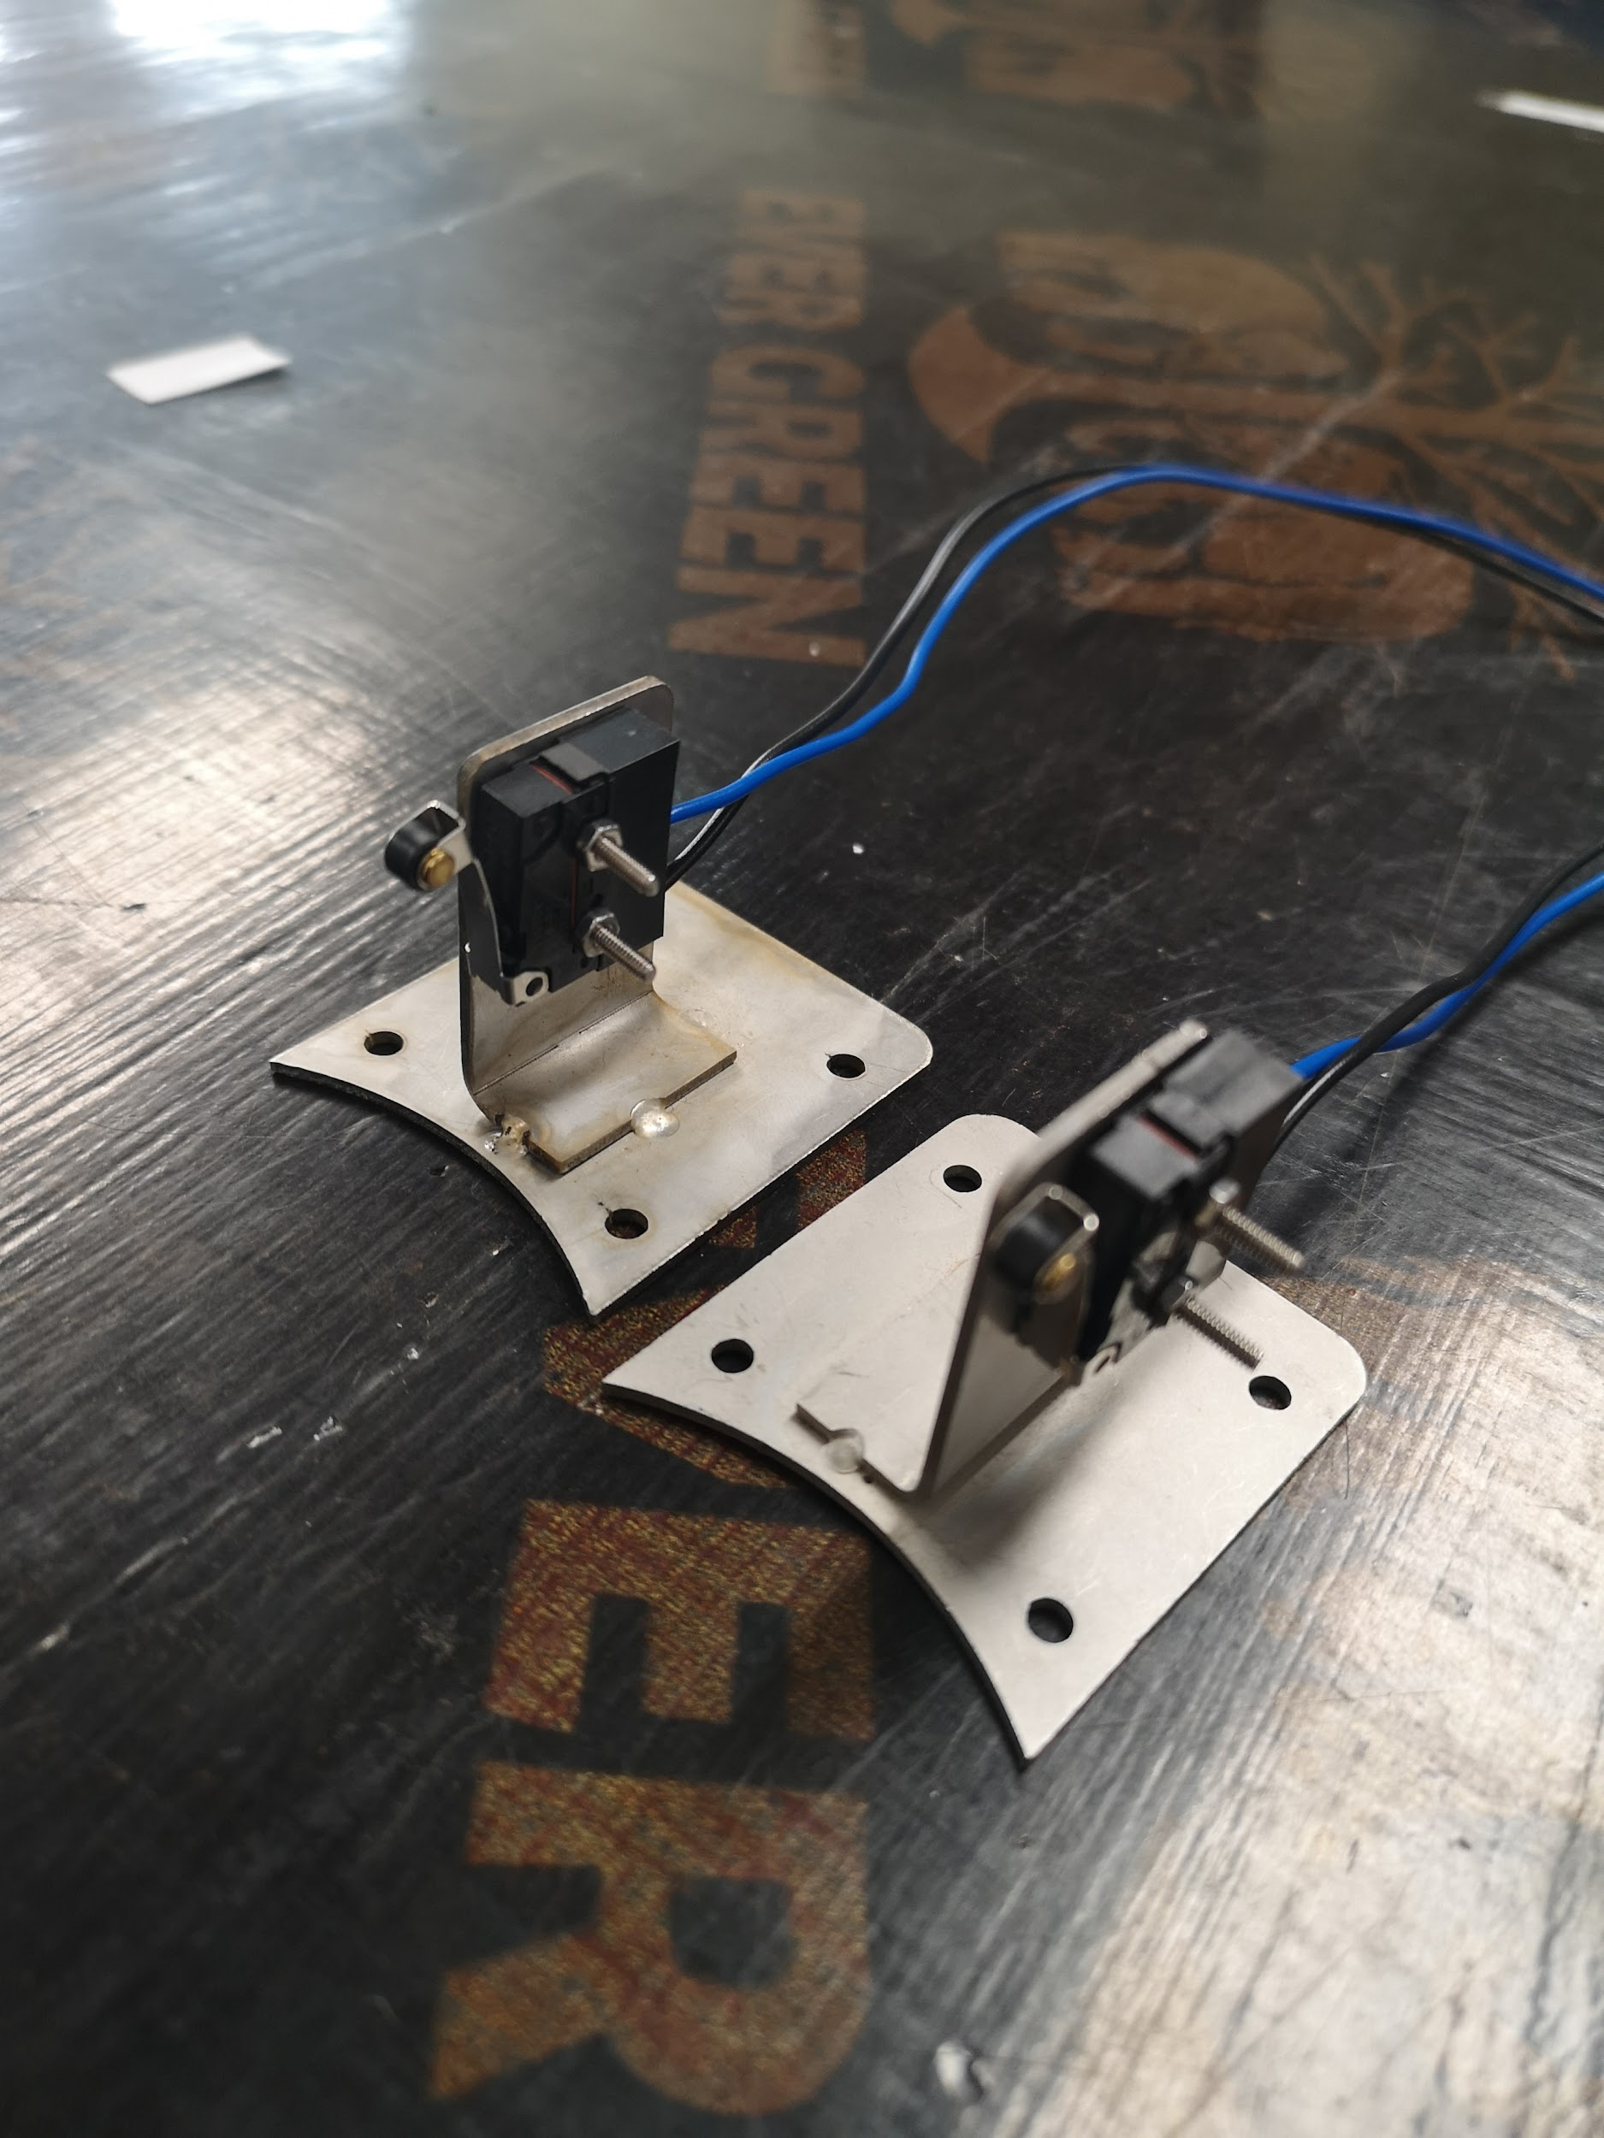
Dock Switch Bracket Orientation
Correct Orientation
Correct Orientation
Wrong Orientation
Wrong Orientation

